Slide 1
MODELS OF INTERACTION

Slide 2
Norman’s model of interaction is perhaps the most influential in Human–Computer Interaction, possibly because of its closeness to our intuitive understanding of the interaction between human user and computer. The user formulates a plan of action, which is then executed at the computer interface. When the plan, or part of the plan, has been executed, the user observes the computer interface to evaluate the result of the executed plan, and to determine further actions. The interactive cycle can be divided into two major phases: execution and evaluation. These can then be subdivided into further stages, seven in all.

Slide 3
1. Establishing the goal.
2. Forming the intention.
3. Specifying the action sequence.
4. Executing the action.
5. Perceiving the system state.
6. Interpreting the system state.
7. Evaluating the system state with respect to the goals and intentions.

Slide 4
Tasks are operations to manipulate the concepts of a domain. A goal is the desired output from a performed task. For example, one task within the graphic design domain is the construction of a specific geometric shape with particular attributes on the drawing surface. A related goal would be to produce a solid red triangle centered on the canvas. An intention is a specific action required to meet the goal.

Slide 5
Norman uses this model of interaction to demonstrate why some interfaces cause problems to their users. He describes these in terms of the gulfs of execution and the gulfs of evaluation. As we noted earlier, the user and the system do not use the same terms to describe the domain and goals – remember that we called the language of the system the core language and the language of the user the task language. The gulf of execution is the difference between the user’s formulation of the actions to reach the goal and the actions allowed by the system. If the actions allowed by the system correspond to those intended by the user, the interaction will be effective.

Slide 6
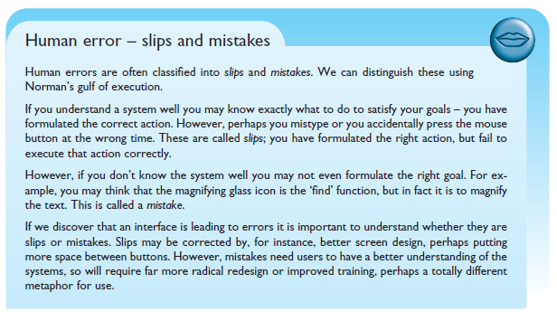
The Gulf of Execution. The gulf of execution is the degree to which the interaction possibilities of an artifact, a computer system or likewise correspond to the intentions of the person and what that person perceives is possible to do with the artifact/application/etc

Slide 7
The interaction framework

Slide 8
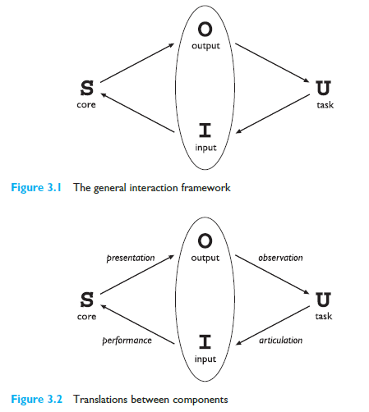

Slide 9
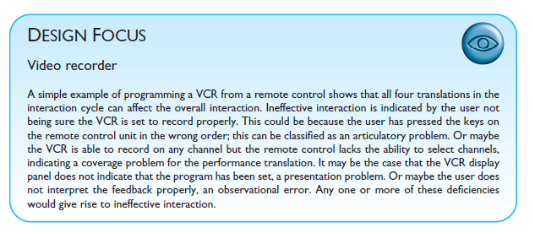

Slide 10
FRAMEWORKS AND HCI

Slide 11
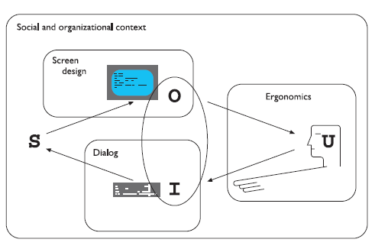

Slide 12
ERGONOMICS
Ergonomics (or human factors) is traditionally the study of the physical characteristics of the interaction: how the controls are designed, the physical environment in which the interaction takes place, and the layout and physical qualities of the screen. A primary focus is on user performance and how the interface enhances or detracts from this. In seeking to evaluate these aspects of the interaction, ergonomics will certainly also touch upon human psychology and system constraints.

Slide 13
Arrangement of controls and displays
functional controls and displays are organized so that those that are functionally related are placed together;
sequential controls and displays are organized to reflect the order of their use in a typical interaction (this may be especially appropriate in domains where a particular task sequence is enforced, such as aviation);
frequency controls and displays are organized according to how frequently they are used, with the most commonly used controls being the most easily accessible.

Slide 14
In addition to the organization of the controls and displays in relation to each other, the entire system interface must be arranged appropriately in relation to the user’s position. So, for example, the user should be able to reach all controls necessary and view all displays without excessive body movement. Critical displays should be at eye level. Lighting should be arranged to avoid glare and reflection distorting displays. Controls should be spaced to provide adequate room for the user to manoeuvre.

Slide 15
Health issues

Slide 16
Perhaps we do not immediately think of computer use as a hazardous activity but we should bear in mind possible consequences of our designs on the health and safety of users. Leaving aside the obvious safety risks of poorly designed safety-critical systems (aircraft crashing, nuclear plant leaks and worse), there are a number of factors that may affect the use of more general computers. Again these are factors in the physical environment that directly affect the quality of the interaction and the user’s performance:

Slide 17
Physical position As we noted in the previous section, users should be able to reach all controls comfortably and see all displays. Users should not be expected to stand for long periods and, if sitting, should be provided with back support. If a particular position for a part of the body is to be adopted for long periods (for example, in typing) support should be provided to allow rest.
Temperature Although most users can adapt to slight changes in temperature without adverse effect, extremes of hot or cold will affect performance and, in excessive cases, health. Experimental studies show that performance deteriorates at high or low temperatures, with users being unable to concentrate efficiently.

Slide 18
Lighting The lighting level will again depend on the work environment. However, adequate lighting should be provided to allow users to see the computer screen without discomfort or eyestrain. The light source should also be positioned to avoid glare affecting the display.
Noise Excessive noise can be harmful to health, causing the user pain, and in acute cases, loss of hearing. Noise levels should be maintained at a comfortable level in the work environment. This does not necessarily mean no noise at all. Noise can be a stimulus to users and can provide needed confirmation of system activity.
Time The time users spend using the system should also be controlled. As we saw in the previous chapter, it has been suggested that excessive use of CRT displays can be harmful to users, particularly pregnant women.

Slide 19
The use of color

Slide 20
Colors used in the display should be as distinct as possible and the distinction should not be affected by changes in contrast. Blue should not be used to display critical information. If color is used as an indicator it should not be the only cue: additional coding information should be included.
The colors used should also correspond to common conventions and user expectations. Red, green and yellow are colors frequently associated with stop, go and standby respectively. Therefore, red may be used to indicate emergency and alarms; green, normal activity; and yellow, standby and auxiliary function. These conventions should not be violated without very good cause.
However, we should remember that color conventions are culturally determined. For example, red is associated with danger and warnings in most western cultures, but in China it symbolizes happiness and good fortune. The color of mourning is black in some cultures and white in others. Awareness of the cultural associations of color is particularly important in designing systems and websites for a global market.

Slide 21
INTERACTION STYLES

Slide 22
Interaction can be seen as a dialog between the computer and the user. The choice of interface style can have a profound effect on the nature of this dialog. Here we introduce the most common interface styles and note the different effects these have on the interaction. There are a number of common interface styles including
command line interface
menus
natural language
question/answer and query dialog
form-fills and spreadsheets
WIMP
point and click
three-dimensional interfaces.

